Slide 1
Lecture 11
Electronic Structure
k-Points Sampling

Slide 2
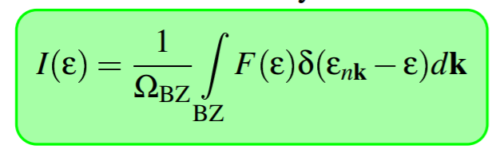
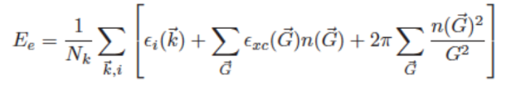
Sampling k-Points
The Brillouin Zone integration is over infinite k-points. Only possible to sum over a finite amount of these.
Large number of k-points means expensive calculation. Poor results with few k-points.

Slide 3
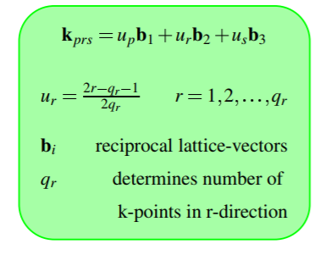
K-point Meshs
How do we choose which k-points to sample?
Monkhorst-Pack Method: Equally spaced k-points in the BZ.
Gamma: k-point mesh is centered within the cell.
Specify the number of k-points to be used in x,y,z and the formula spaces them out.

Slide 4
Rules of Thumb
Should always test for the minimum number of k-points required.
K-points don’t always scale with system. Symmetry of mesh matters, so even/odd number of k-points changes the scaling.
Metals generally require more k-points than insulators and semiconductors.
Should always use the same number of k-points in each reciprocal direction for uniform systems.

Slide 5

Fermi Level Smearing
For insulators, there is a bandgap at the Fermi level which allows continuous integration over k-space.
Not the case with metals. The Fermi level cuts through some bands.
The integrand can be transformed to contain a delta function. Vasp parameters SIGMA and ISMEAR control this.

Slide 6

Summary of Smearing Methods
Gaussian - Approximate integrand as a Gaussian. (ISMEAR = 0)
Methfessel and Paxton - Expand the integrand as a product of Hermite polynomials and Gaussians. (Commonly used for metals, ISMEAR > 0).
Linear Tetrahedron with Blöchl corrections - Break up the BZ into tetrahedrons and interpolate the integrand. (ISMEAR = -4 or -5)

Slide 7
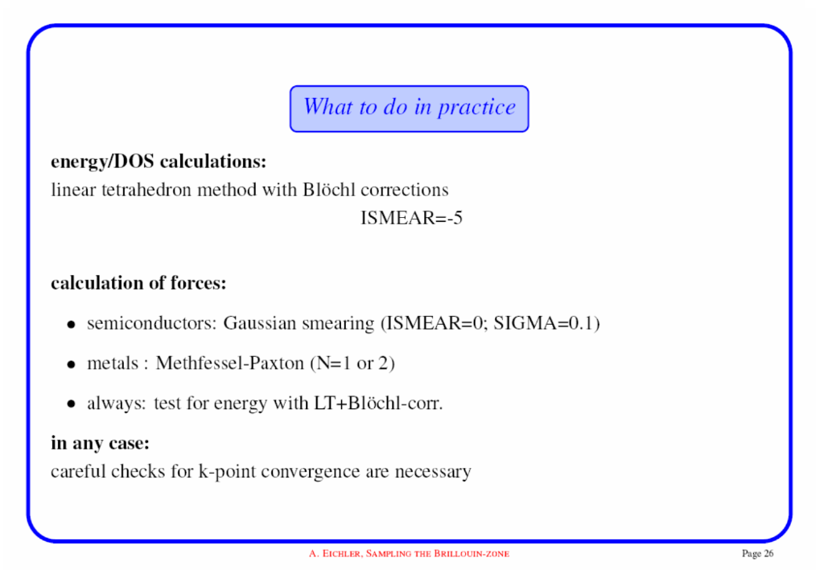

Slide 8
